Slide 1
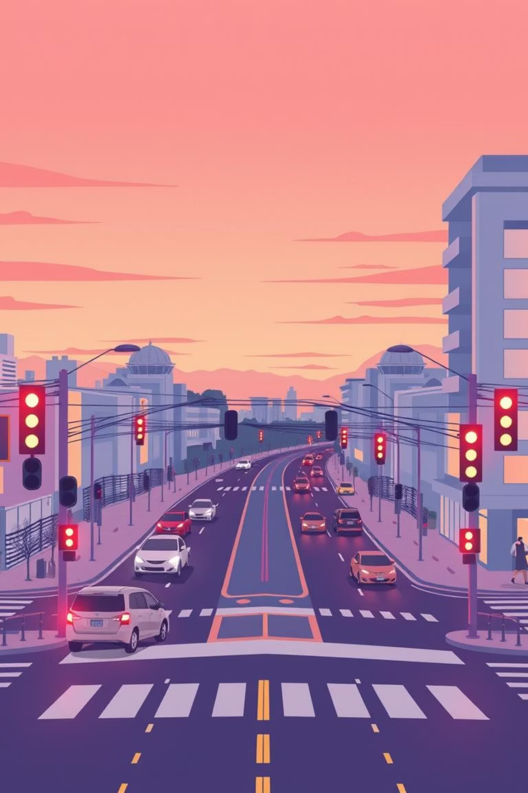
DRLE: Decentralized Reinforcement Learning at the Edge for Traffic Light Control in the IoV
Presented by Pengyuan Zhou, Xianfu Chen, Zhi Liu, Tristan Braud, Pan Hui, Jussi Kangasharju
Team Number : 8

Slide 2
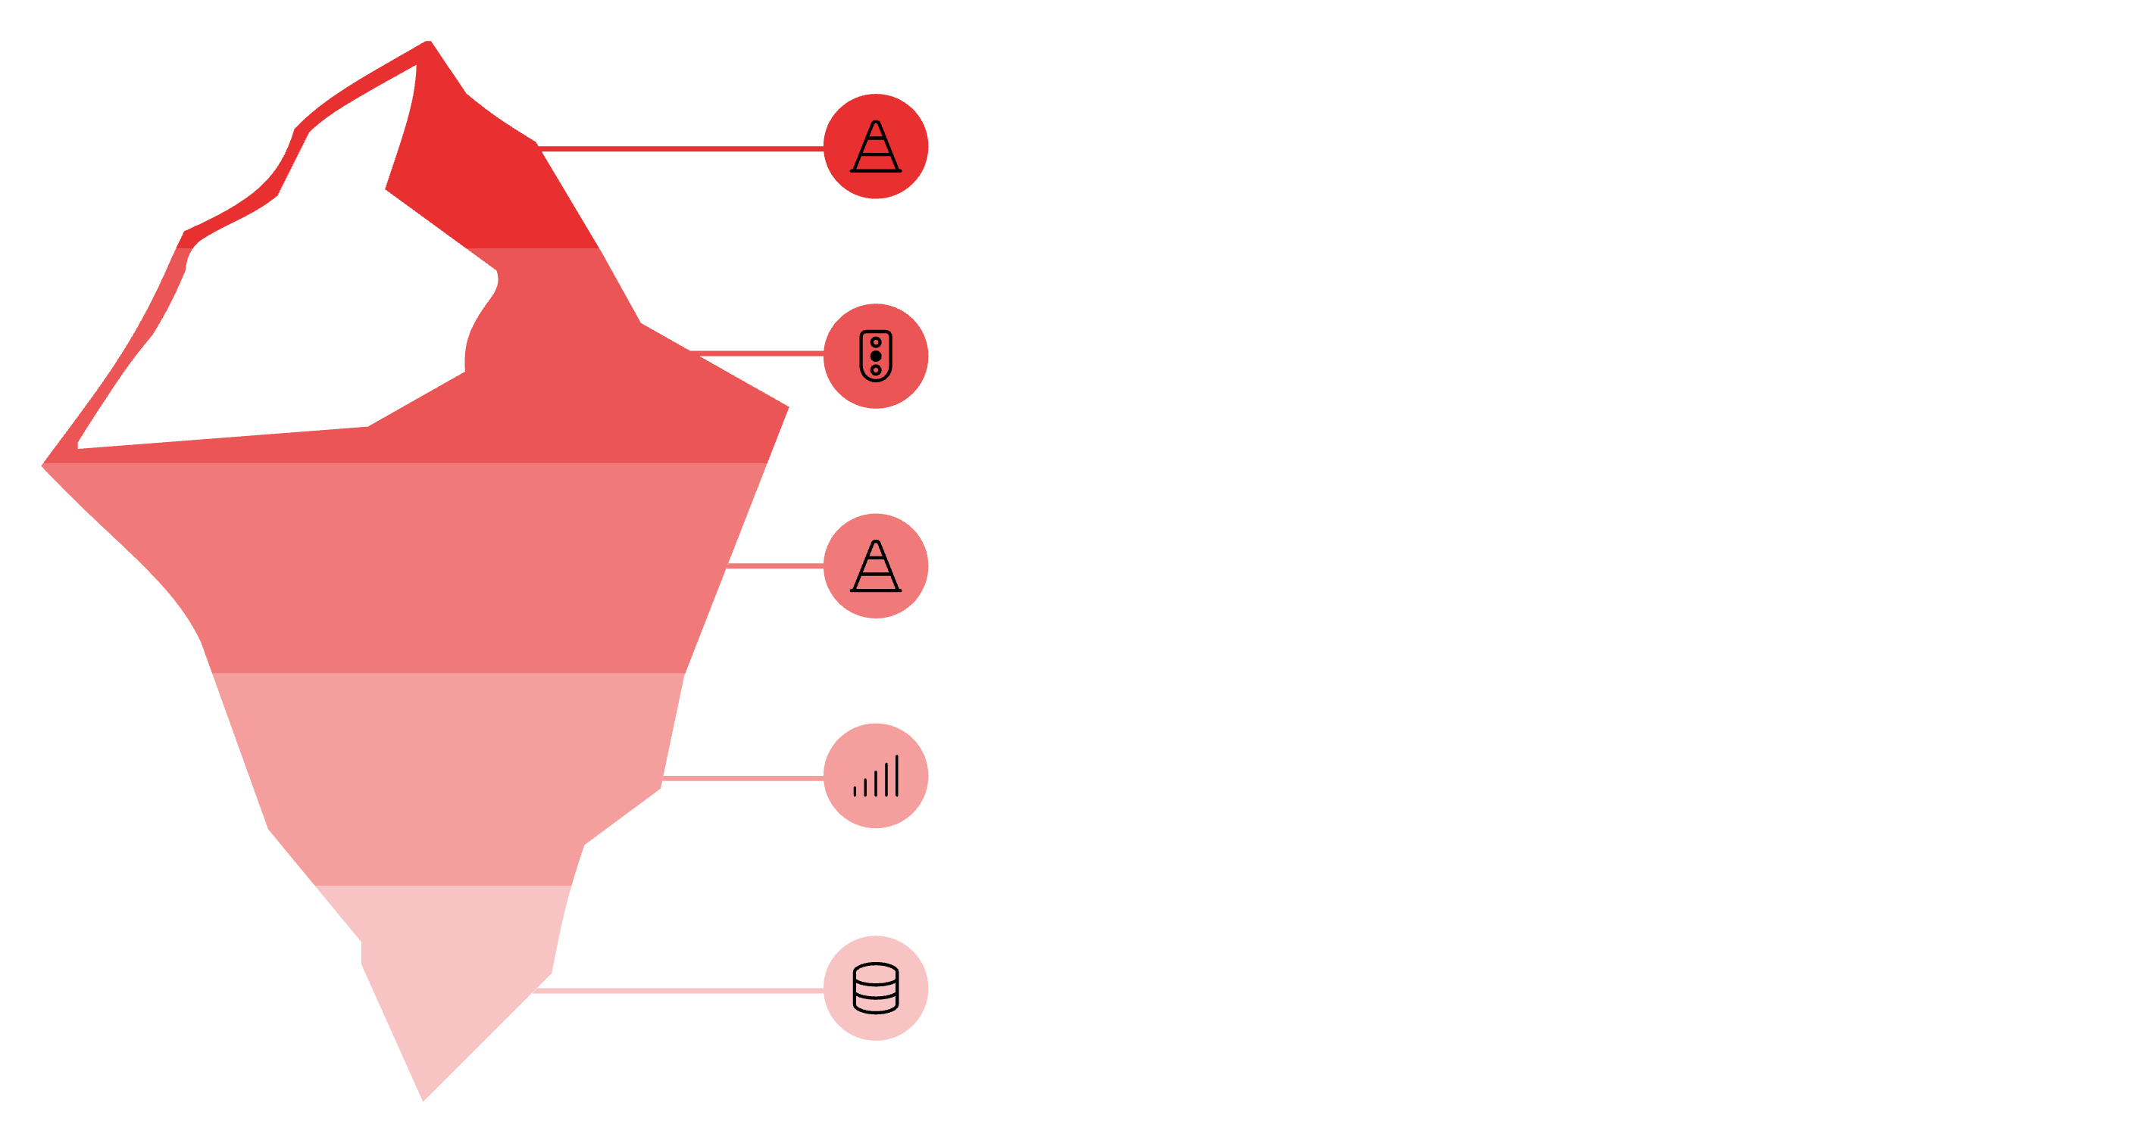





The Urban Traffic Dilemma: A Growing Challenge
Urban traffic congestion is worsening despite advances in connected vehicles and real-time data. Traditional and centralized traffic light systems struggle to adapt quickly or scale efficiently across large networks. Many modern approaches remain limited by high computational demands, reliance on perfect models, or lack of proven real-world performance.
Visible Traffic Issues
Traditional traffic light systems are rigid
Centralized control systems struggle to handle large-scale city networks
Current advanced methods
Many existing solutions lack real-world deployability

Slide 3
Limitations of Existing Traffic Control Methods
Linear Programming – Optimizes signals using traffic models but needs highly accurate data, lacks learning ability, and can’t adapt to unexpected situations.
Single‑Agent RL – One controller for all intersections; suffers from huge state/action spaces, making it slow and resource‑heavy for large cities.
Multi‑Agent RL – Multiple controllers reduce complexity, but existing methods are often not deployable, lack proof of optimality, and use non‑standard simulators that limit reproducibility.

Slide 4
Approach Proposed in The Paper
This paper proposes Decentralized Reinforcement Learning at the Edge (DRLE) to tackle urban traffic congestion by combining the Internet of Vehicles (IoV) with edge computing. Unlike existing multi‑agent RL methods, which often lack real‑world deployability, mathematical proof of optimality, and credible large‑scale testing, DRLE addresses all three. It uses multiple local agents each controlling its own intersection organized in a three‑level edge computing hierarchy. Real‑time traffic data from connected vehicles is processed at nearby edge servers, enabling low‑latency, scalable, and adaptive traffic light control. The approach is mathematically proven to achieve global optimal performance and is validated through large‑scale simulations on open‑ source platforms, showing faster convergence and better efficiency than existing methods.

Slide 5
Why it's an Edge Problem
Latency Requirements – Traffic lights need to respond in real time to changing traffic flow. If all data had to go to a distant cloud server first, delays could make the control decisions outdated. Edge computing processes data closer to intersections, reducing reaction time.
Scalability – A centralized system would have to handle massive amounts of traffic data from an entire city, which becomes slow and inefficient. Edge servers (ES1 and ES2) distribute the load by handling data locally.
Local Data Utilization – IoV devices (vehicles, roadside units) generate valuable data right where the traffic is happening. Processing it at the edge improves accuracy and responsiveness while reducing unnecessary network traffic to the cloud.

Slide 6
State of the Art Literature: Centralized DRL (2018)
Paper: Deep Reinforcement Learning for Traffic Light Control in Vehicular Networks
Authors: Xiaoyuan Liang et al.
His foundational work applied Deep Reinforcement Learning (DRL) with a centralized controller for traffic lights. While effective for single intersections, its limitations became apparent when scaled:
Scalability Issues
Struggled to handle the complexity and data volume of large urban networks.
High Latency
Centralized data transfer introduced significant delays, making real-time response challenging.
Single Point of Failure
A breakdown in the central controller could cripple the entire system

Slide 7
Multi-Agent DRL (2020)
Paper: Multi-Agent Deep Reinforcement Learning for Urban Traffic Light Control in Vehicular Networks
By: Tong Wu et al.uilding on centralized DRL, 2020 saw the rise of multi-agent approaches, aiming to distribute control closer to the problem source.
Decentralized Agents
Each traffic intersection was assigned its own independent DRL agent for localized control.
Centralized Training
Despite decentralized execution, agents still relied on a centralized critic during the training phase.
Enhanced Scalability
Significant improvements in handling larger networks and dynamic traffic patterns compared to single-agent systems.
Partial Independence
While more adaptable, the dependency on a centralized critic for training limited true autonomy.

Slide 8
DRLE: Our Contribution to Traffic Control
Paper: DRLE: Decentralized Reinforcement Learning at the Edge for Traffic Light Control in the IoV
DRLE introduces a groundbreaking approach to urban traffic management, leveraging fully decentralized
Deep Reinforcement Learning (DRL) directly at the network edge. This eliminates the need for central
coordination, fostering resilience and real-time adaptability.
Fully Decentralized Local Data Reliance
Each traffic light operates autonomously at the edge. Utilizes real-time data from connected vehicles (IoV).
No Central Authority
Operates without a central controller or critic.
Achieved Performance Waiting Time Reduction
Through this innovative architecture, DRLE delivers significant improvements. Achieved in traffic flow optimization upto 52%.
Training Speed
Efficient learning curve.
Greenwave Learning
Self-optimizing patterns.
Mathematical Optimality
Guaranteed performance.

Slide 9
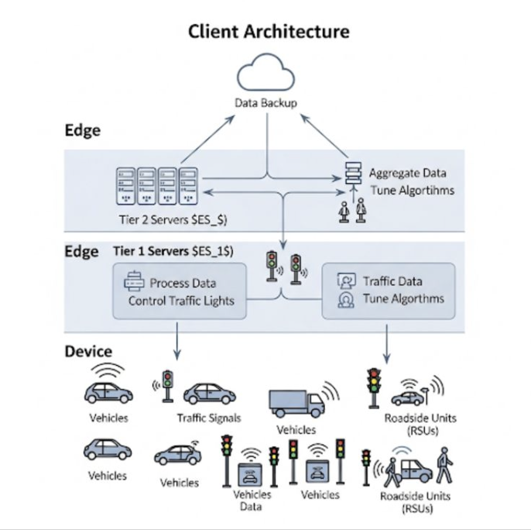
Architecture Diagram

Slide 10
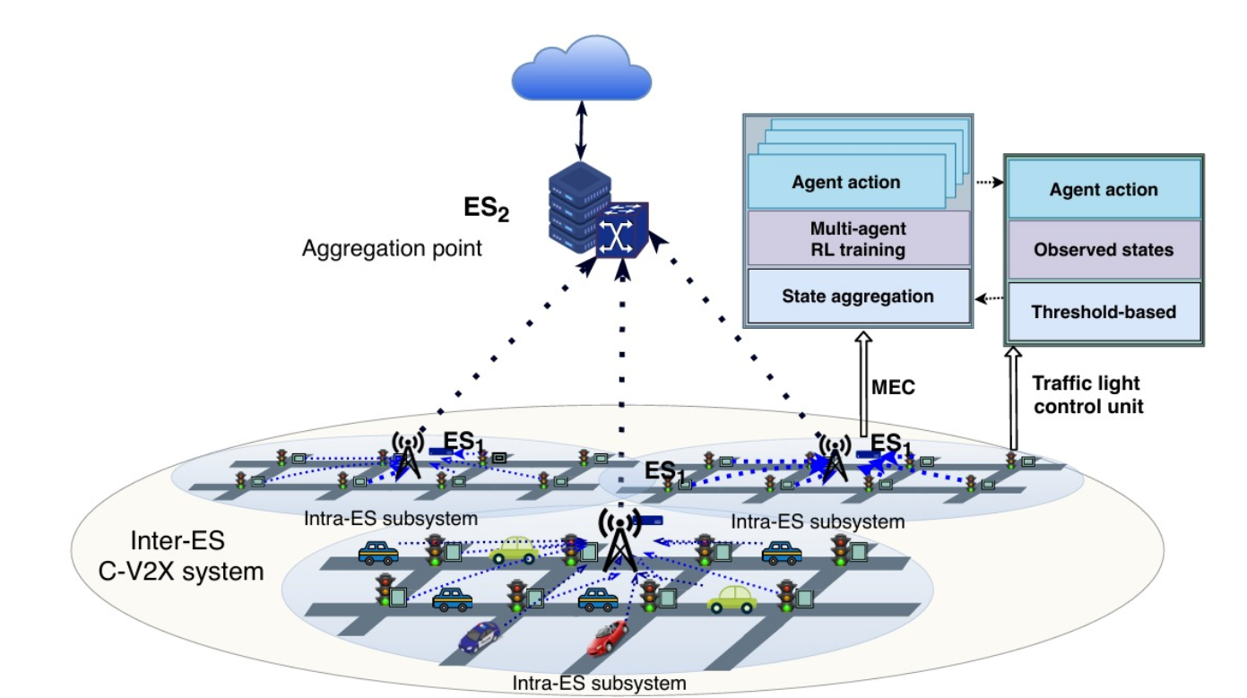

Slide 11
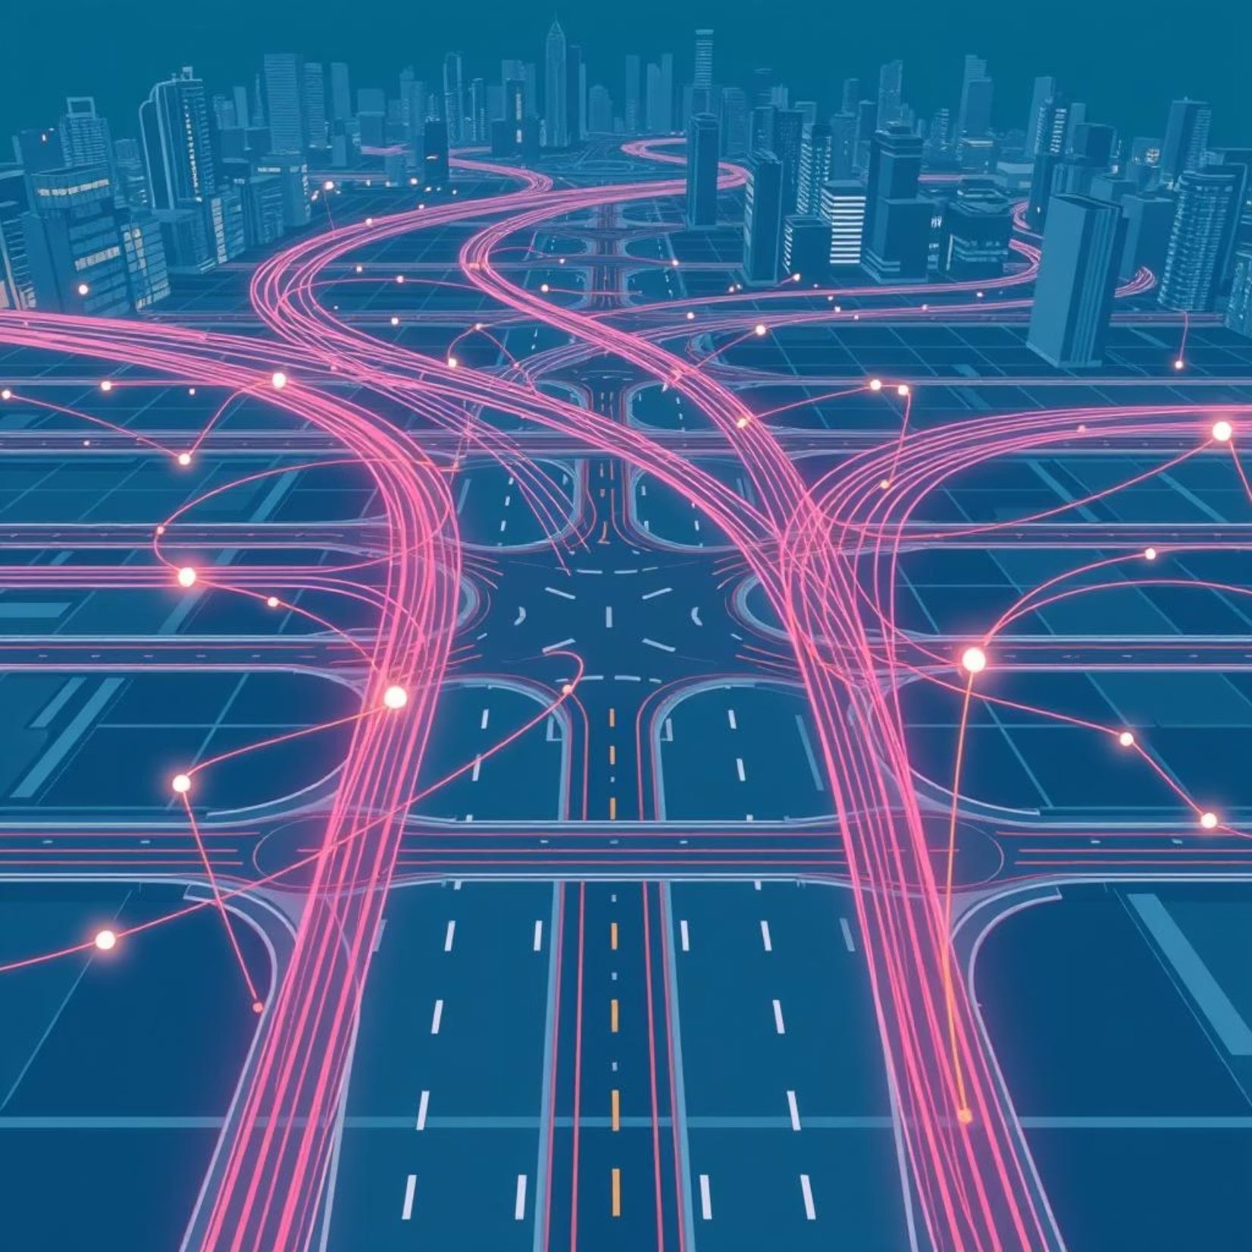
Implementation Strategy & Evaluation
SUMO → Traffic simulator only. It handles vehicles, intersections, roads, and signal timing.
Flow → A Python framework that connects SUMO (or other traffic simulators) with reinforcement learning libraries so you can train agents to control traffic lights.
RLlib → The reinforcement learning library itself — this is where the DQN algorithm runs.
NS-3 – Simulates the communication network between vehicles, roadside units, and edge servers, adding delays to make the simulation realistic.

Slide 12
Team Task Allocation for DRLE Development
A structured approach ensured comprehensive coverage of all aspects of the DRLE project.
1
Simulation & Environment Setup
2
Algorithm Development & Integration
Configure SUMO for realistic traffic modeling.
Integrate with Flow for reinforcement learning experiments.
Prepare dependencies and ensure reproducibility across setups.
Implement the DRLE multi-agent DQN control framework.
Adapt and test algorithm variants
Integrate edge-oriented control layers (Intersection, ES1, ES2).
3
Training & Performance Evaluation
4
Communication & Scalability Analysis
Run experiments on multiple network sizes (5×5, 10×10, 15×15).
Measure and analyze key traffic metrics: halting vehicles, queue time, queue length, speed, convergence.
.
Model V2X communications and measure latency impacts using simulation tools (e.g., NS‑3).
Assess DRLE scalability across larger urban grids and increasing agent counts.

Slide 13
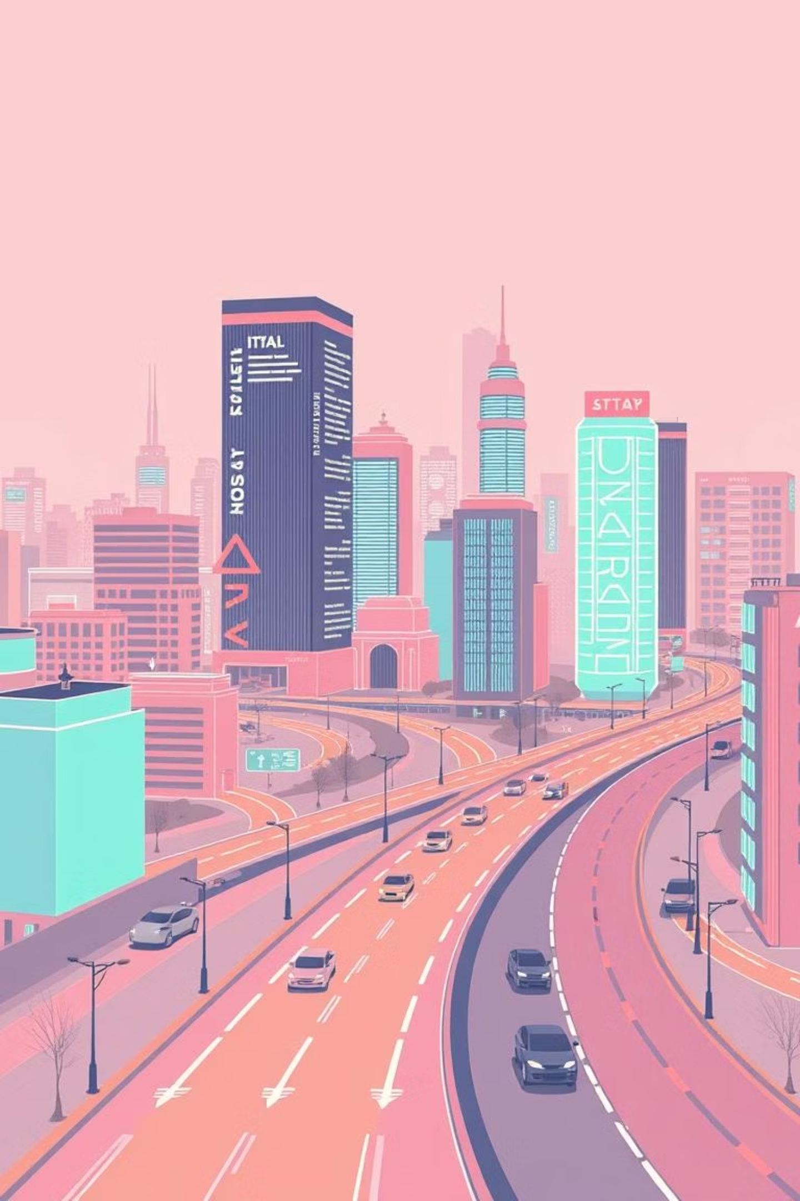
DRLE: The Future of Smart City Traffic
DRLE stands as a scalable, real-time, and intelligent edge-based solution for smart city traffic management, showcasing clear advantages over traditional centralised models through robust theoretical guarantees and comprehensive experimental validation.
This framework marks a significant leap towards truly adaptive and efficient urban mobility systems.

Slide 14
DQN Algorithm Overview in DRLE
What is DQN?
Deep Q‑Network (DQN) is a reinforcement learning method that uses a neural network to estimate Q‑values.
In DRLE, each intersection has an agent running DQN to decide the next traffic light phase.
How DQN Works in DRLE
Input:
Real‑time traffic data from IoV devices at the intersection:
Queue lengths on each approach
Waiting times of vehicles
Current traffic light phase
Number of incoming vehicles
.

Slide 15
DQN Learning Process in DRLE
Process:
The DQN agent takes this input and estimates how good each possible action would be
It uses a neural network to predict these “goodness” values (Q‑values) for every possible action.
The agent then chooses an action sometimes the best‑predicted one, sometimes a random one (to explore new strategies).
After the action is applied, the environment (traffic) changes, and the agent gets feedback in the form of a reward (e.g., reduced queue = positive reward).
Multi‑Agent Integration:
Intersection Level: Simple threshold control for immediate response.
Intra‑ES Level (ES1): Multiple DQN agents optimize their intersections locally.
Inter‑ES Level (ES2): Coordinates ES1 agents and tunes learning parameters in real time.
Why DQN in DRLE?
Handles large state spaces better than basic Q‑learning.
Learns adaptively from live IoV data.
Scales well in a decentralized multi‑agent setup.

